Slide 1
Innovative test solution
Provider
- Probe pin Data Sheet -

Slide 2
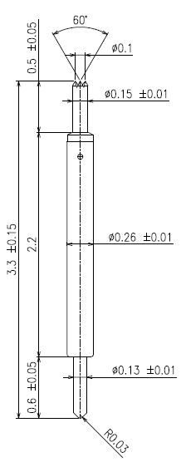
※ POGO type – 0.35 pitch
IVB-SAR-330-026-A088-00
Pitch | 0.35mm
Total Length | 3.3mm
Use Length | 2.9mm
Use Stroke | 0.4mm
Recommended Top Plunger Stroke | 0.15mm
Recommended Bottom Plunger Stroke (Pre-load) | 0.25mm
Max Stroke | 0.5mm
Spring Force at Use Stroke | 22gf at 0.4mm Stroke
Operating Temperature | -40 to 125°C
DC Resistance | Avg. 68.50mΩ at 0.4mm stroke
Current Rating | 1.0A
Self Inductance | 0.97 nH
Bandwidth @ -3dB | 28.50 GHz
Top Plunger | BeCu / Au over Ni
Bottom Plunger | BeCu / Au over Ni
Barrel | Phosphor bronze / Au over Ni
Spring | Music Wire / Au over Ni
Insertion Life | 100,000 cycles at 0.4mm Stroke

Slide 3
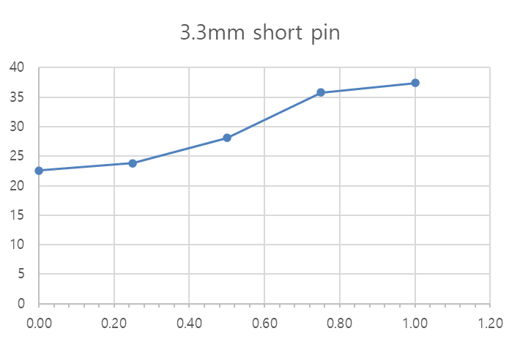
※ General POGO pin – 3.3mm / 0.35P
IVB-SAR-330-026-A088-00
3.3mm short pin
Current (A) | Temp. (T)
0.00 | 22.6
0.25 | 23.80
0.50 | 28.10
0.75 | 35.80
1.00 | 37.40

Slide 4
Thank you.

